Slide 1
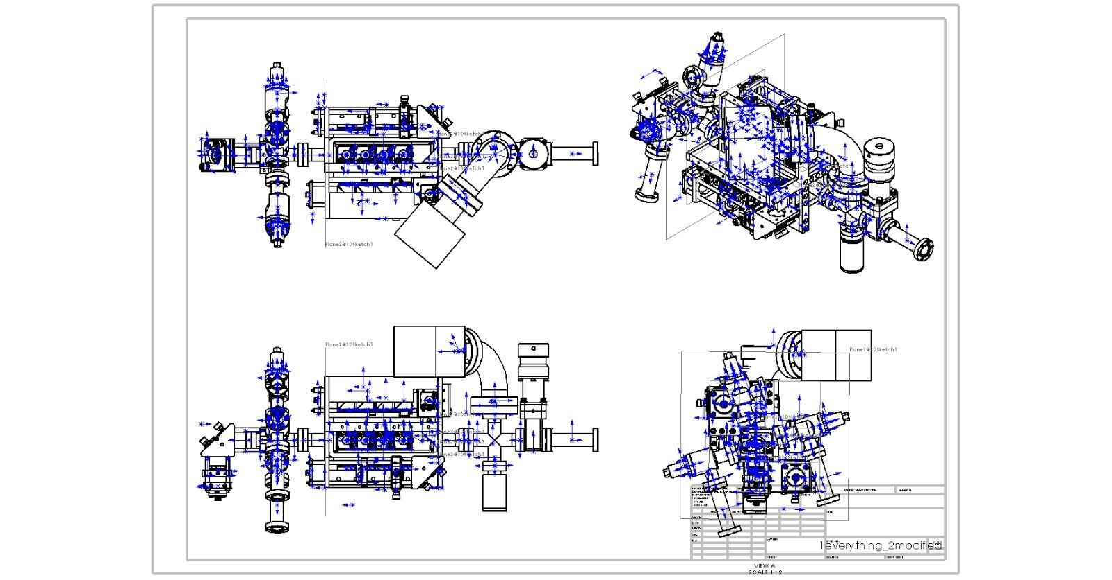
Rb oven
Ion pump
Push beam
Gate valve
K oven
Cell
Mounting crosses
To 3-D MOT
Rotatable flag

Slide 3
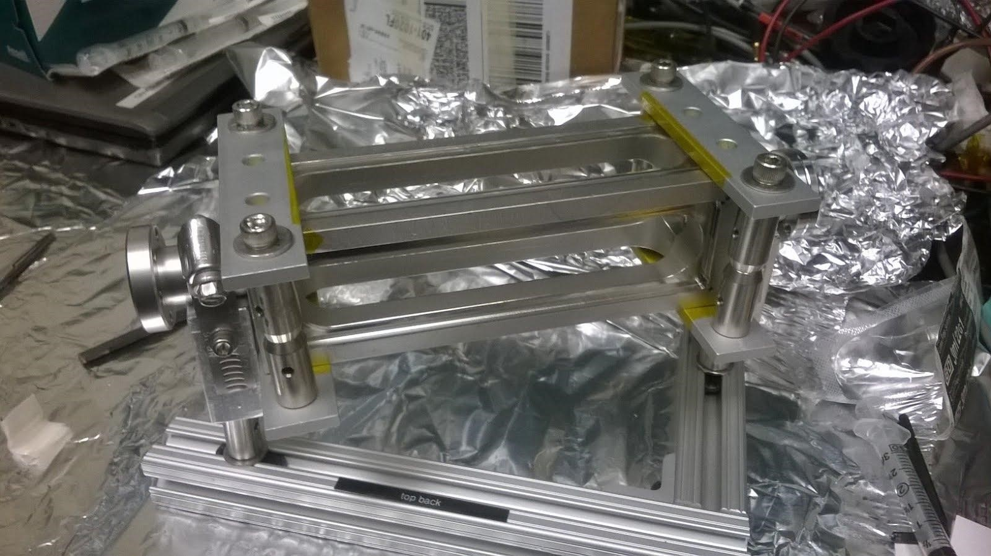
Clamps
Rotatable
mini conflat
connector
Mini conflat
connector
AR coated windows
Stainless Cell

Slide 4
